Slide 1


Slide 2
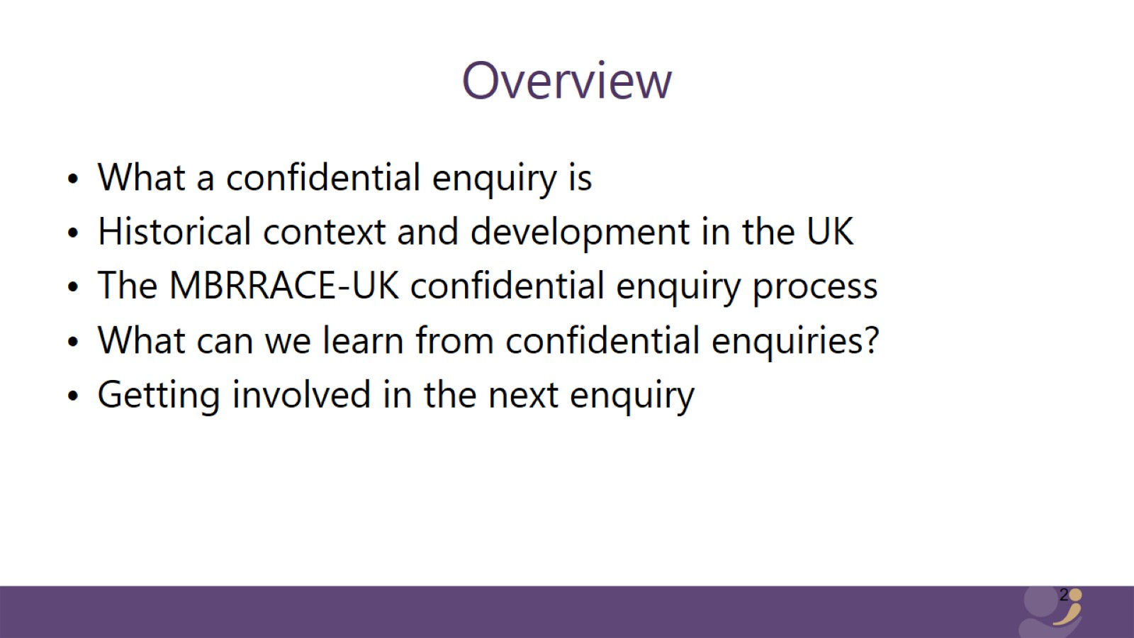
Overview

Slide 3
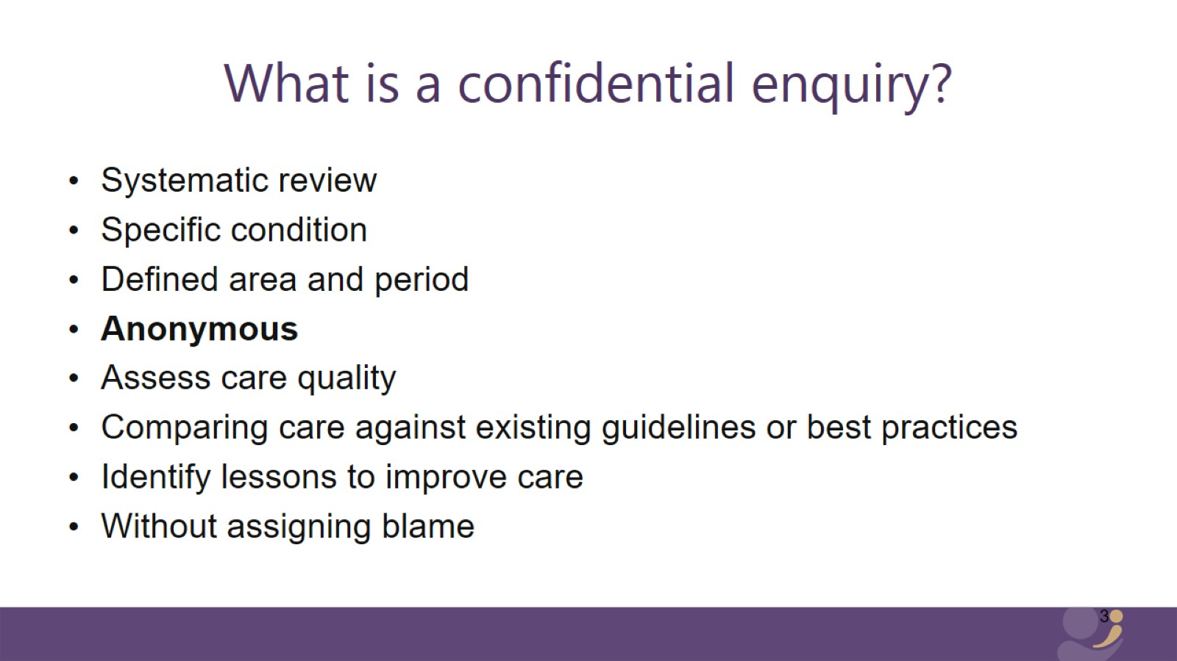
What is a confidential enquiry?

Slide 4
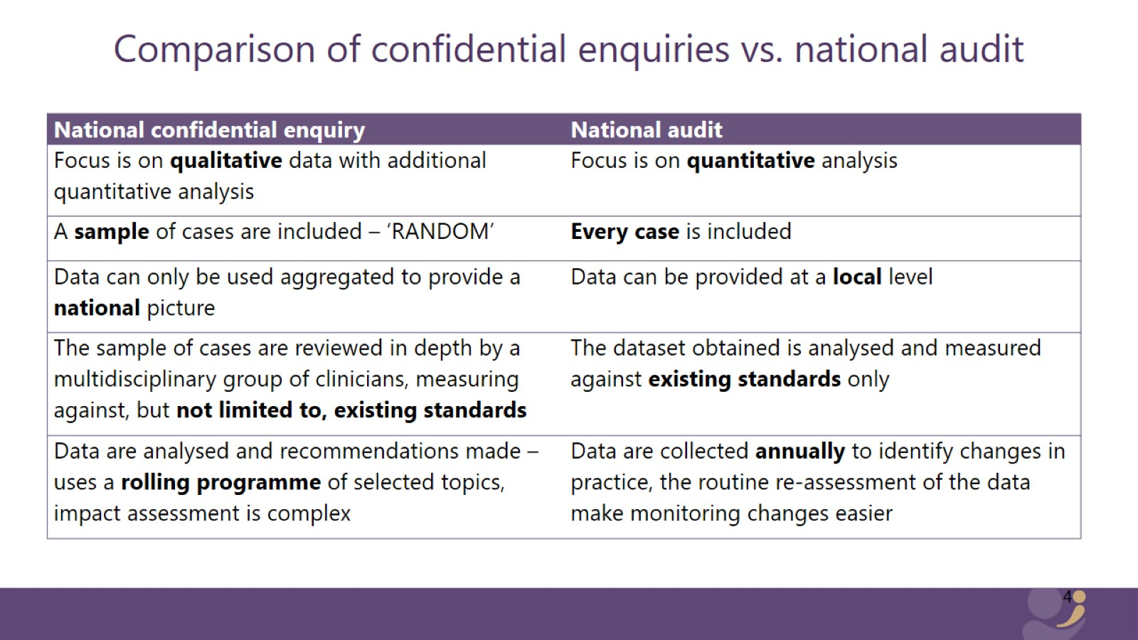
Comparison of confidential enquiries vs. national audit

Slide 5
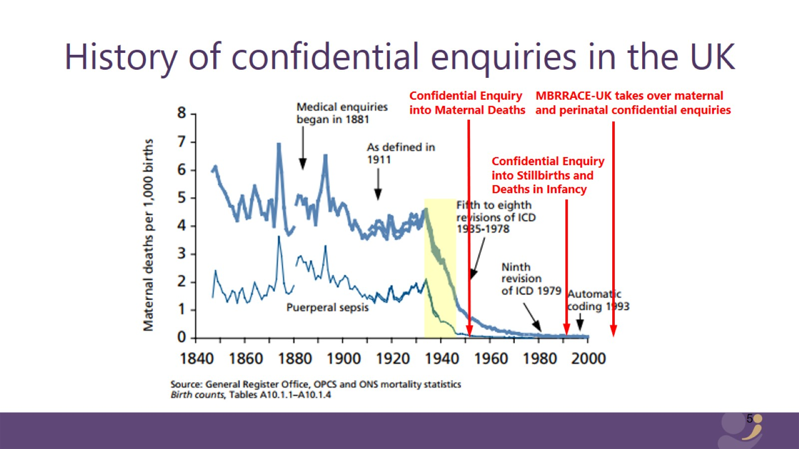
History of confidential enquiries in the UK

Slide 6


Slide 7
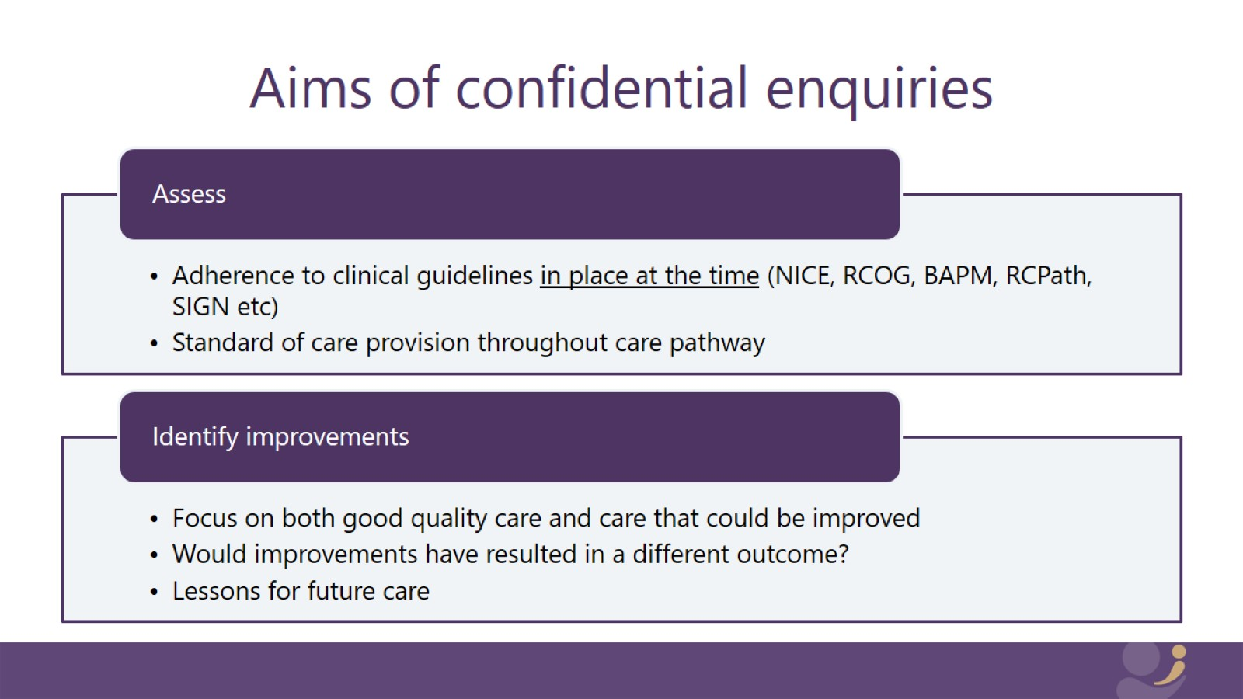
Aims of confidential enquiries

Slide 8
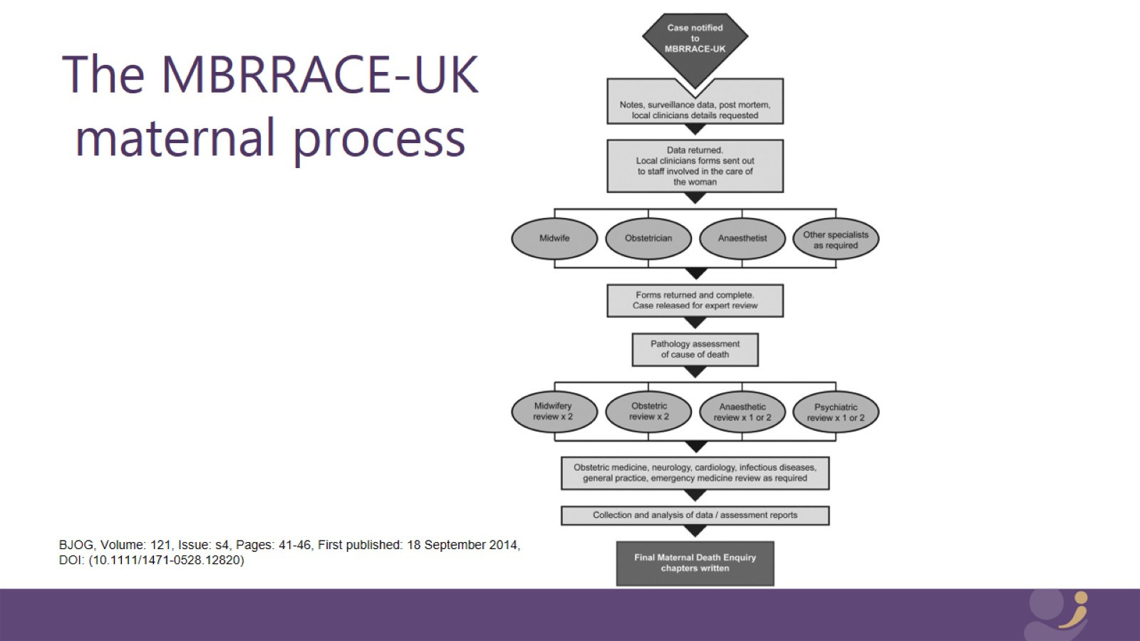
The MBRRACE-UK maternal process

Slide 9
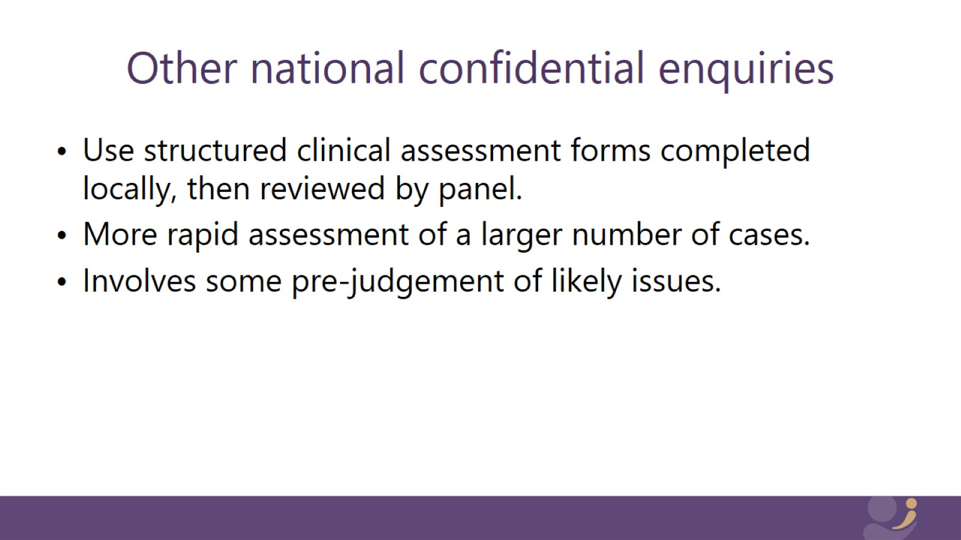
Other national confidential enquiries

Slide 10
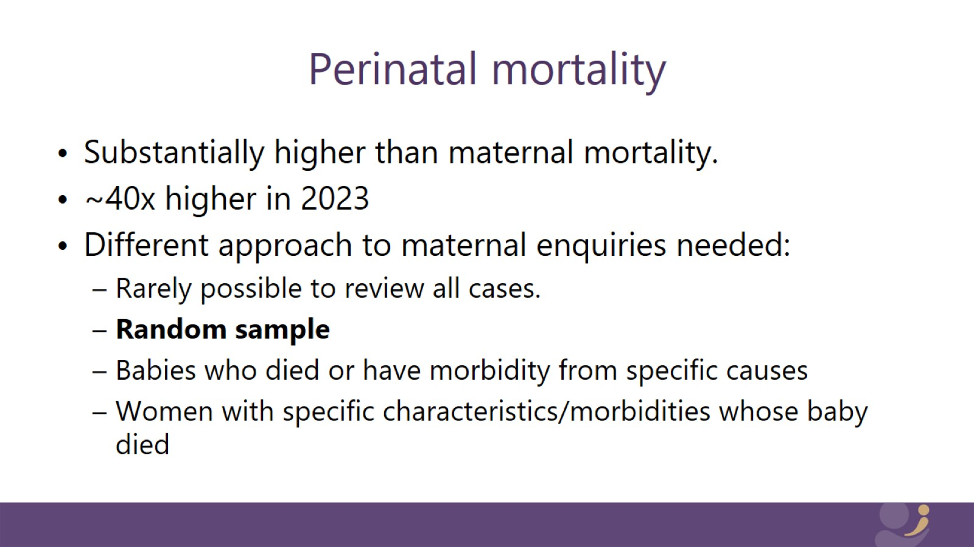
Perinatal mortality

Slide 11
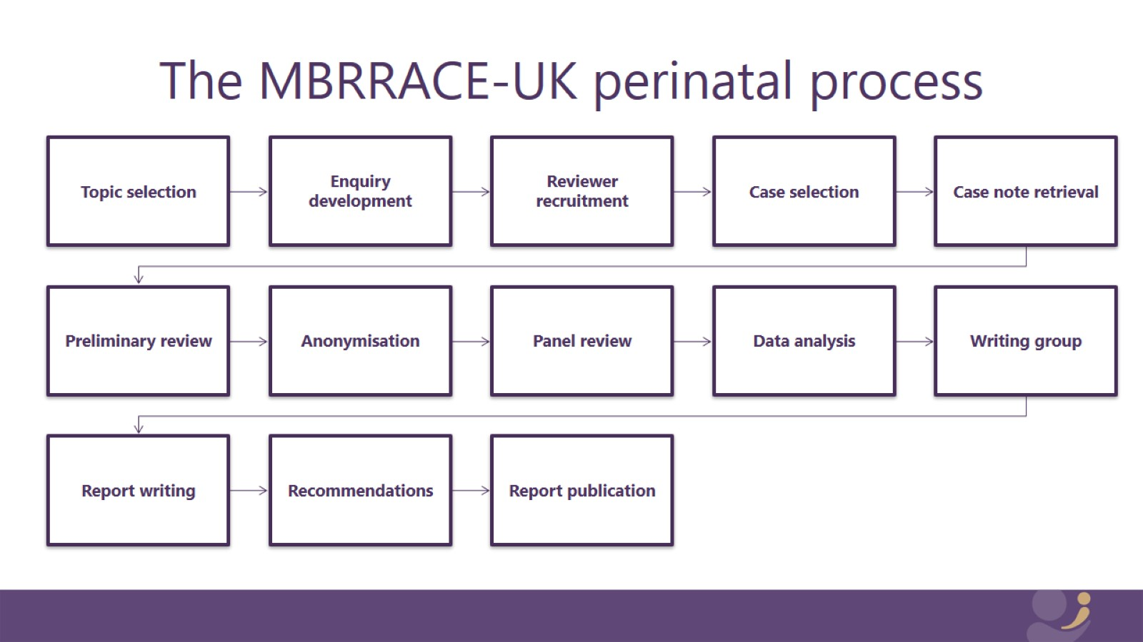
The MBRRACE-UK perinatal process

Slide 12
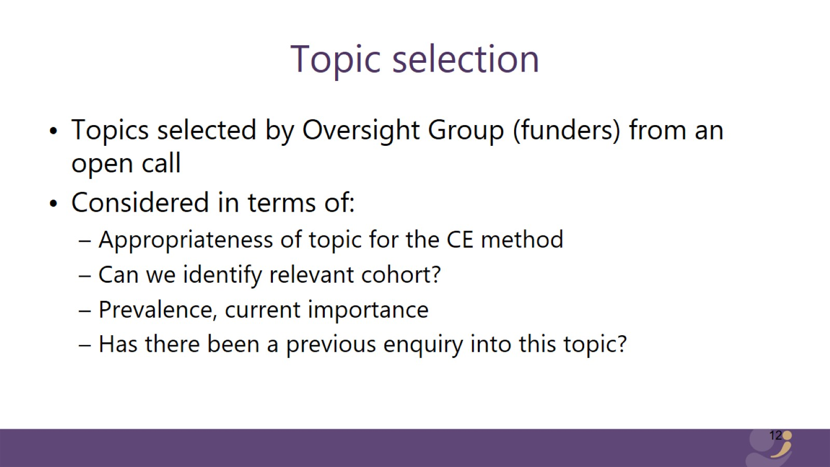
Topic selection

Slide 13
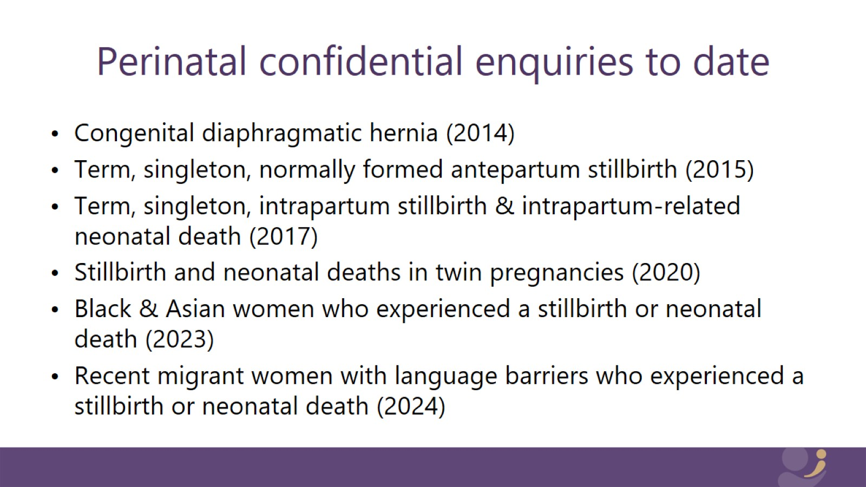
Perinatal confidential enquiries to date

Slide 14
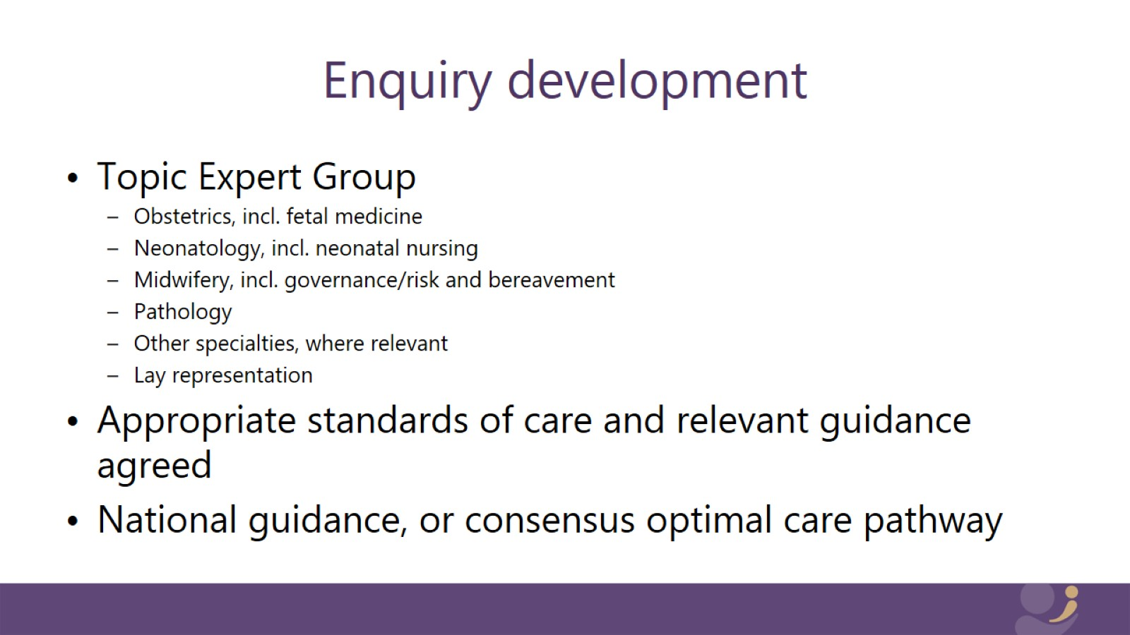
Enquiry development

Slide 15
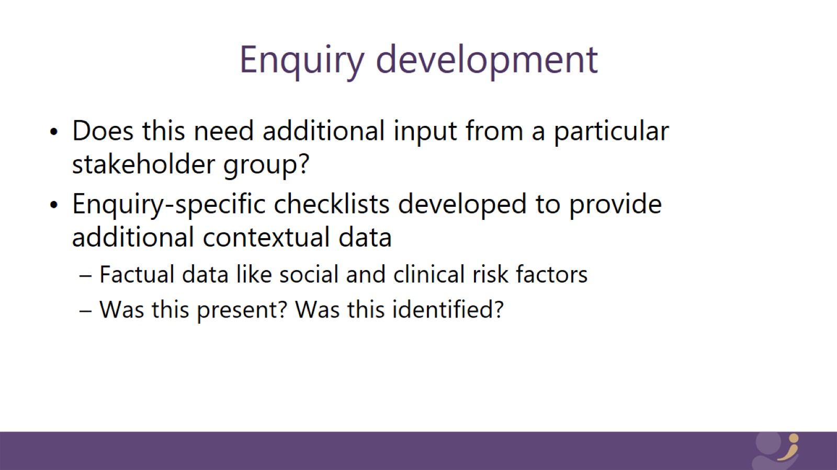
Enquiry development

Slide 16
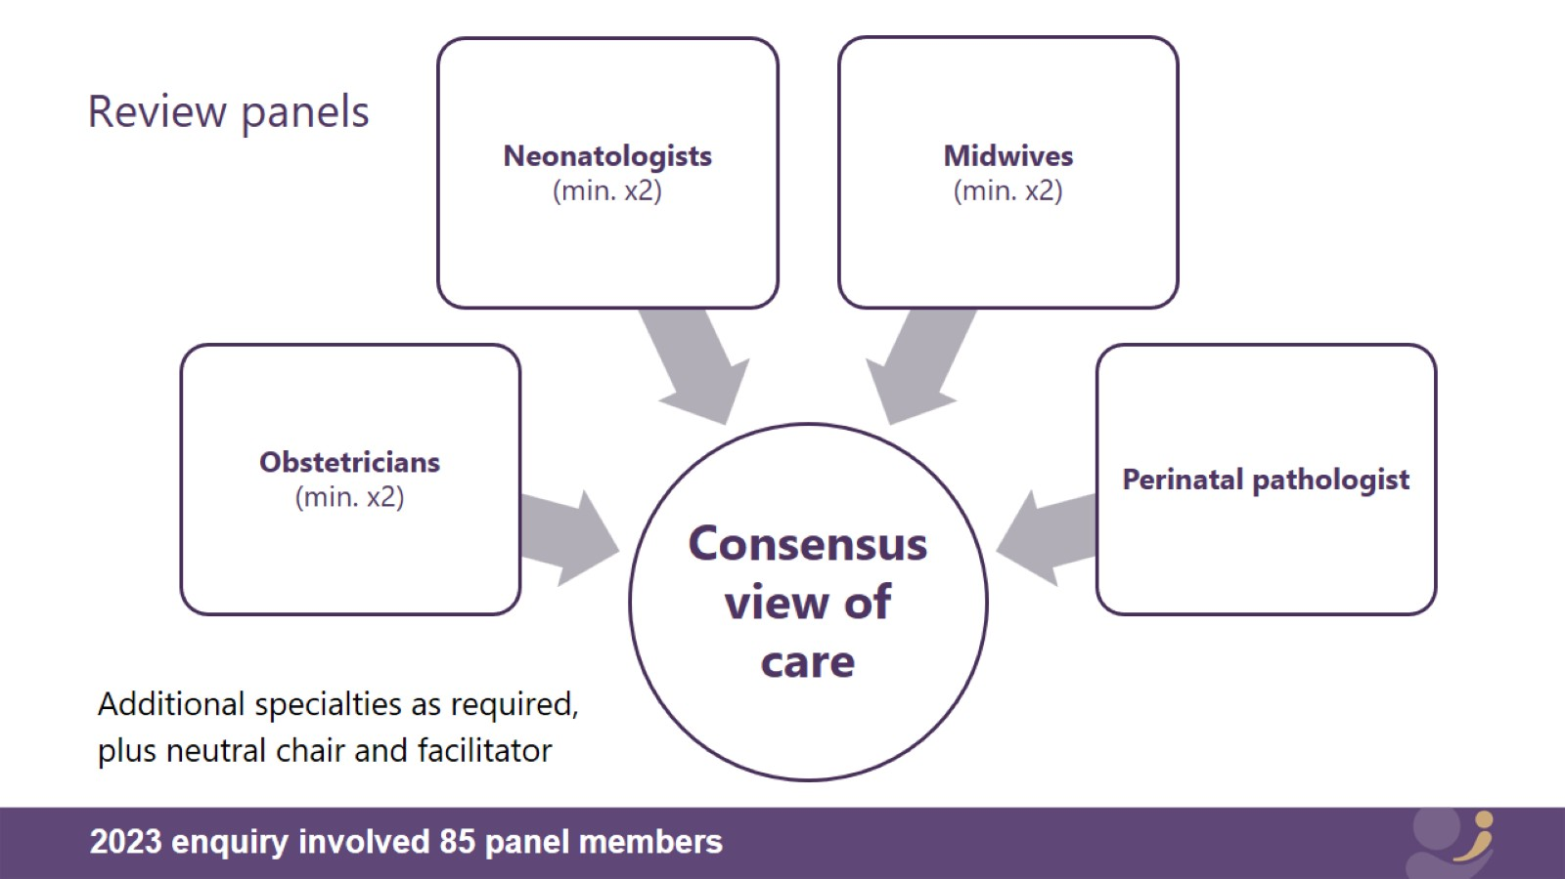
Review panels

Slide 17
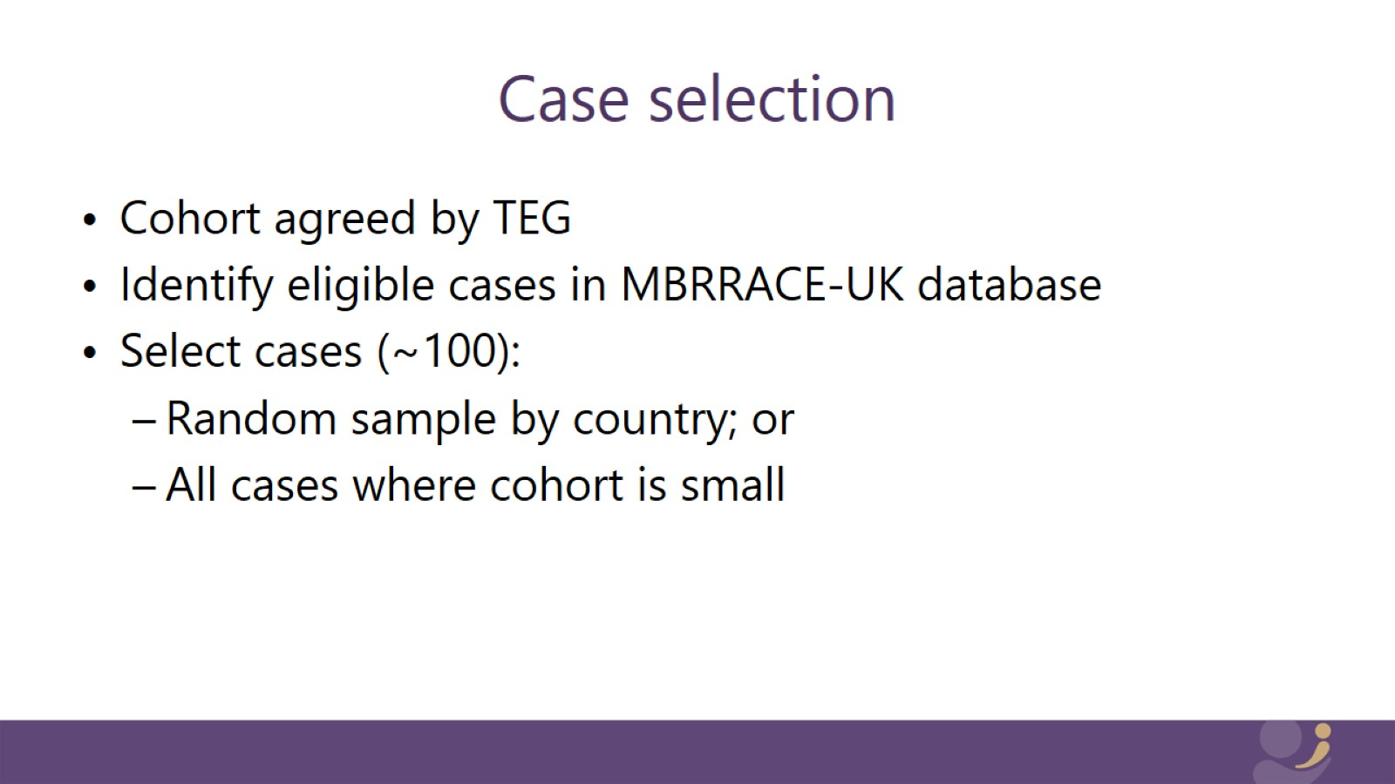
Case selection

Slide 18
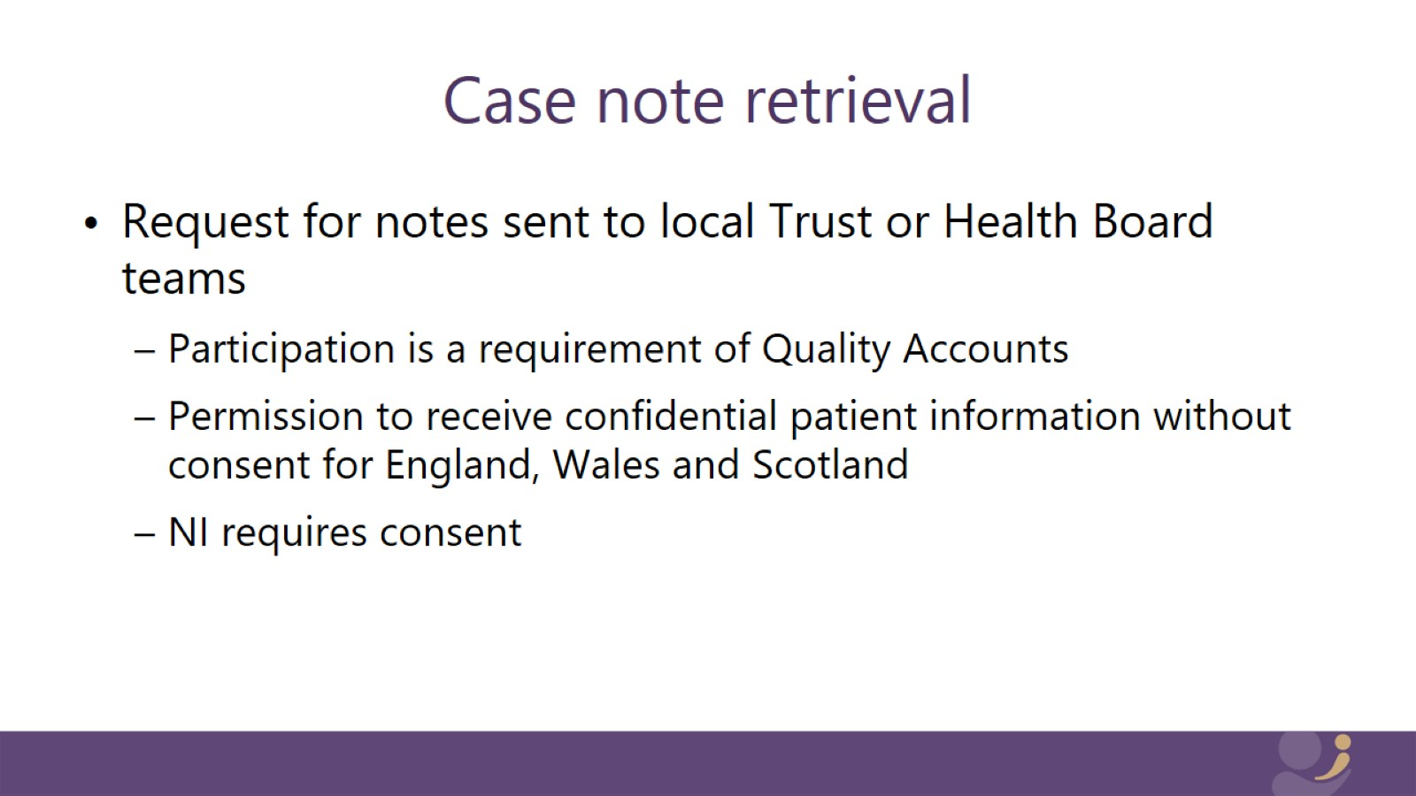
Case note retrieval

Slide 19
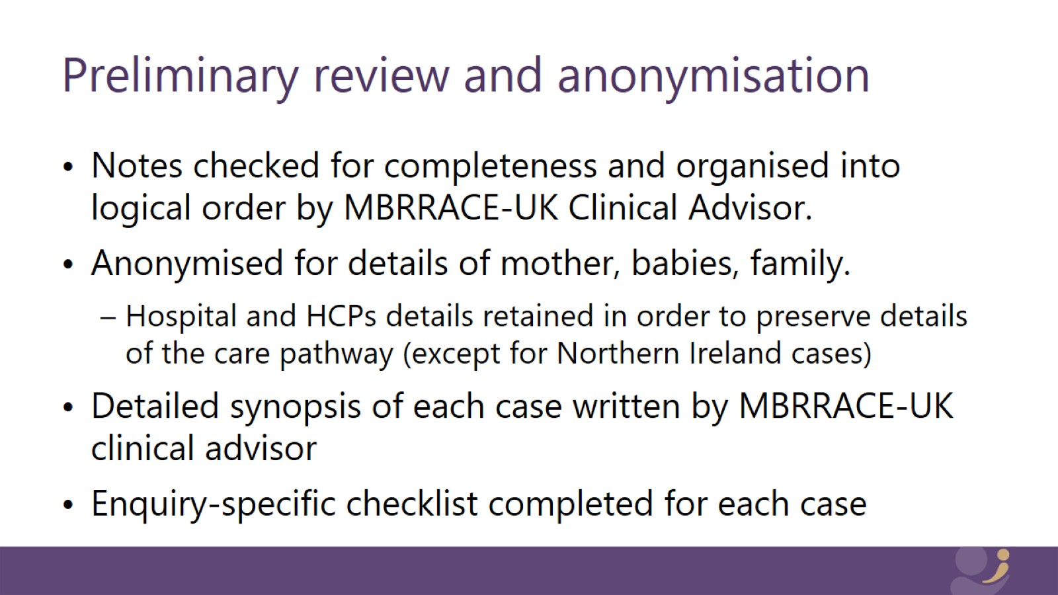
Preliminary review and anonymisation

Slide 20
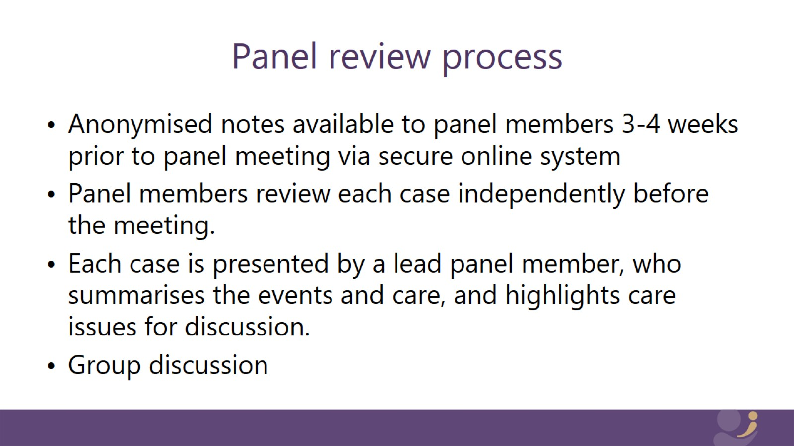
Panel review process

Slide 21
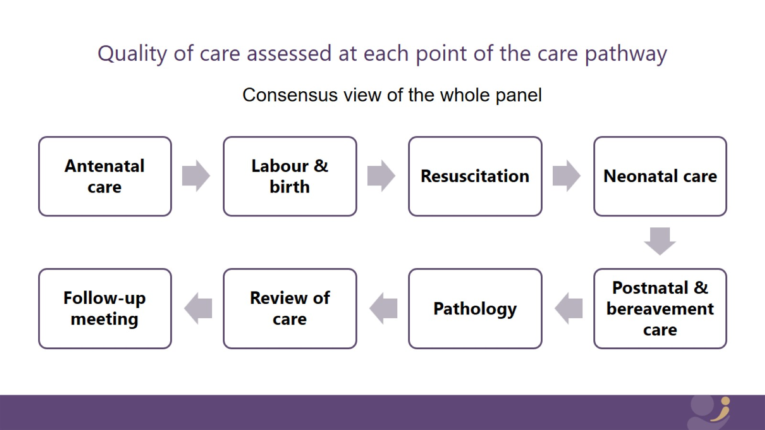
Quality of care assessed at each point of the care pathway

Slide 22
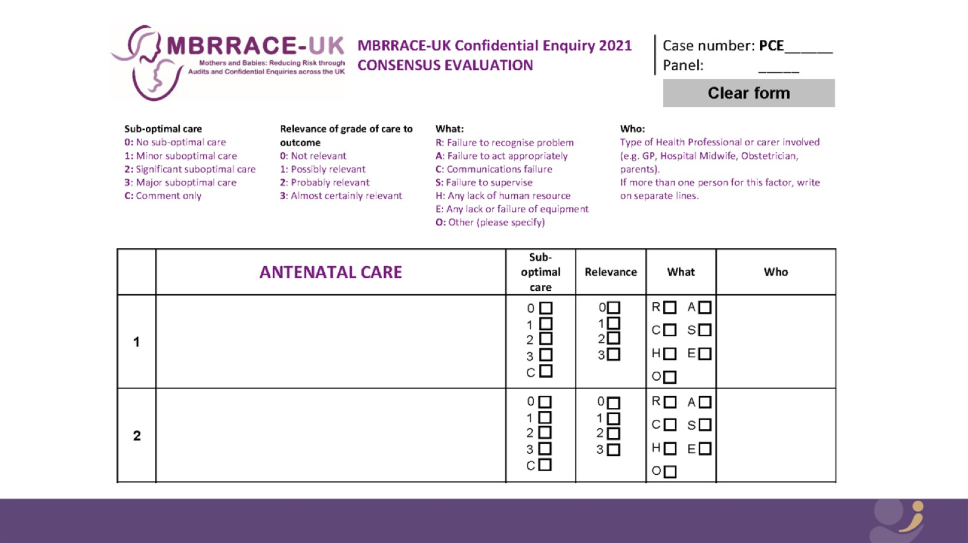

Slide 23
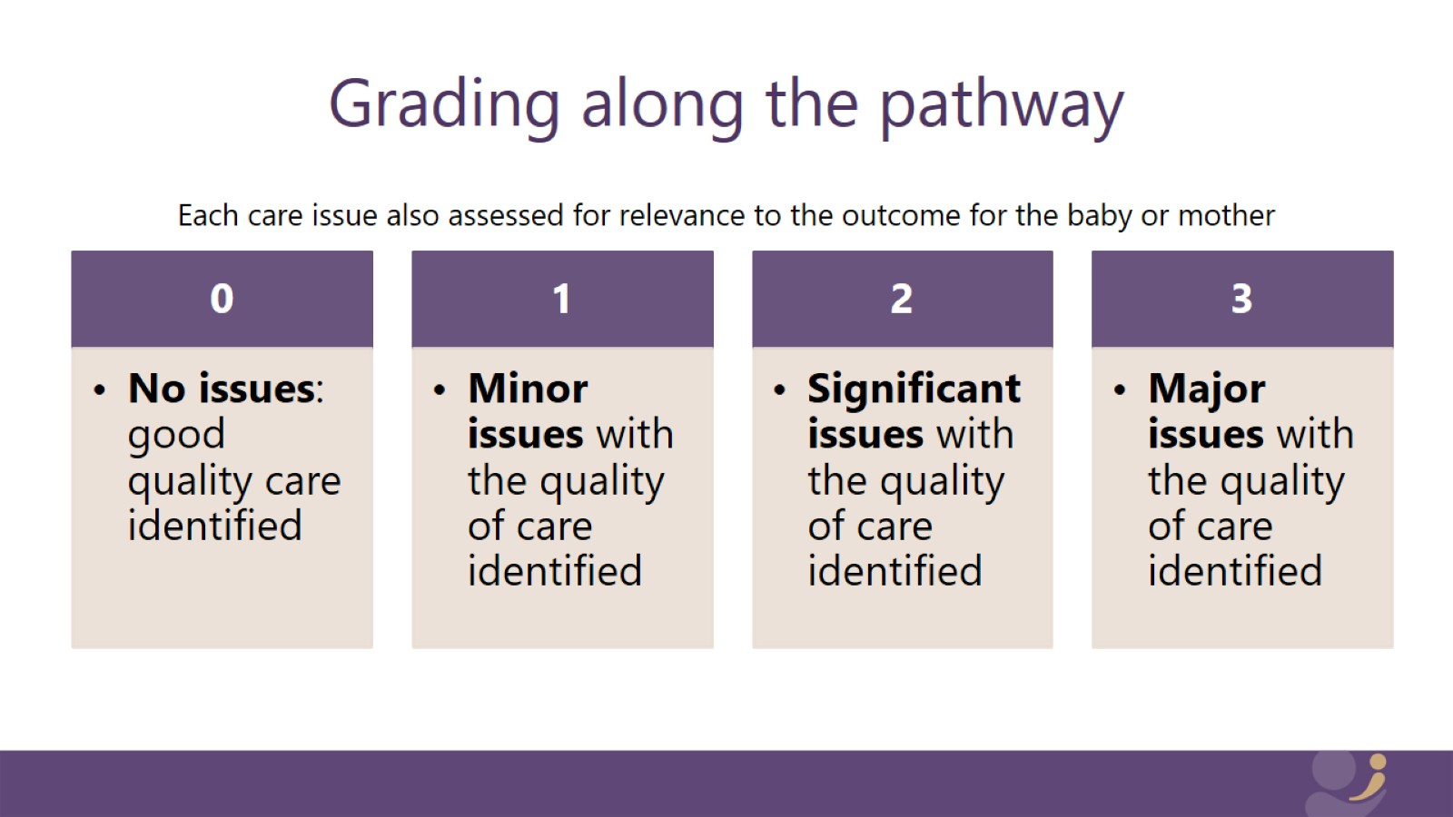
Grading along the pathway

Slide 24
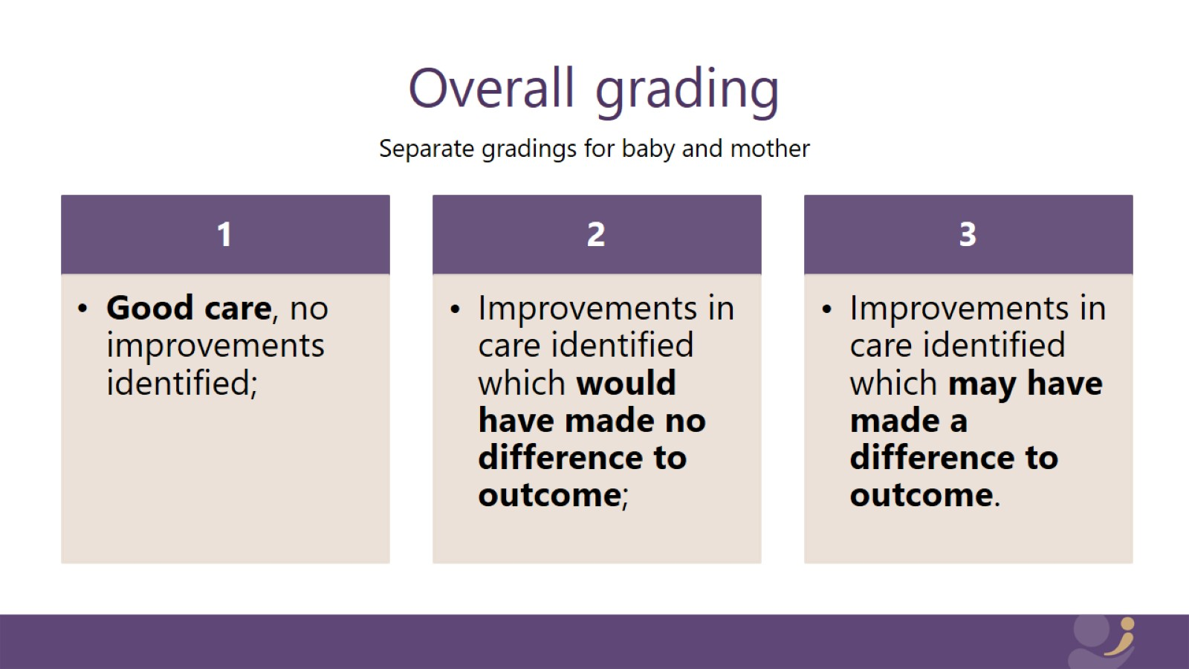
Overall grading

Slide 25
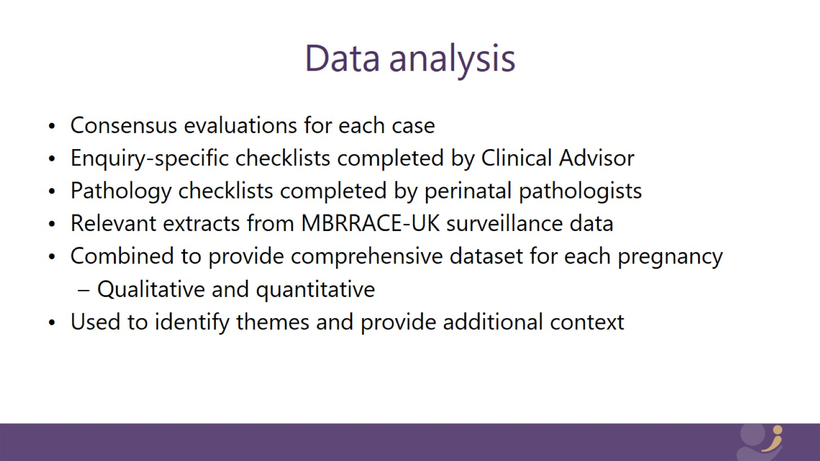
Data analysis

Slide 26
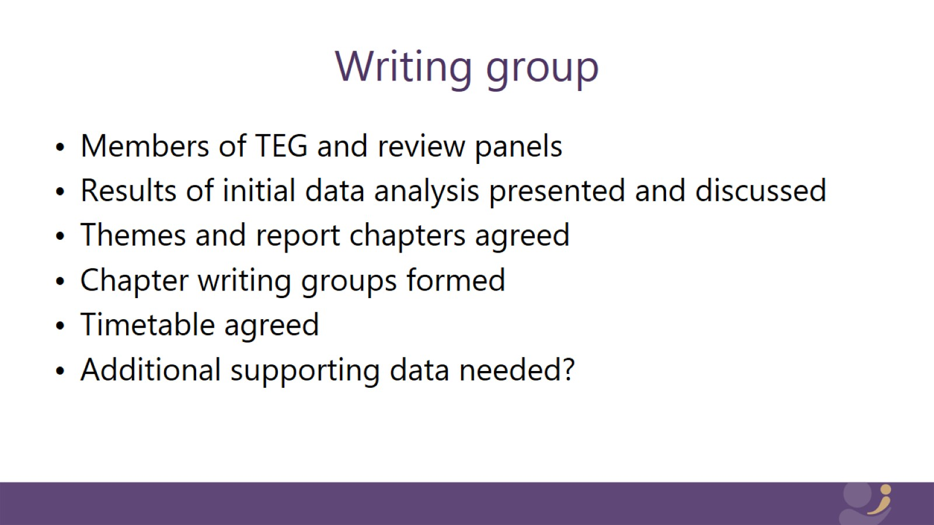
Writing group

Slide 27
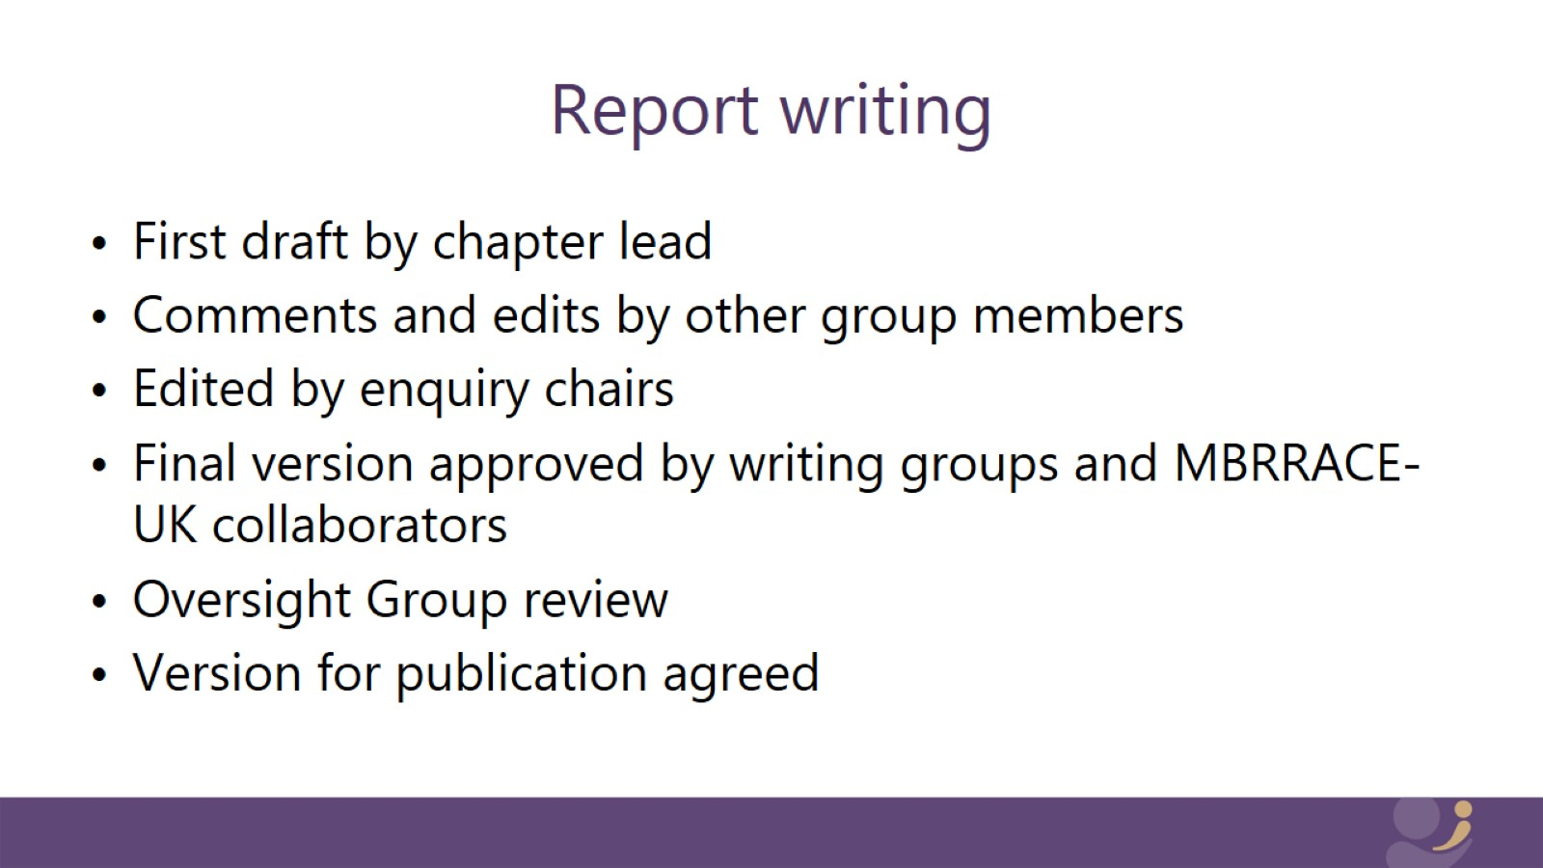
Report writing

Slide 28
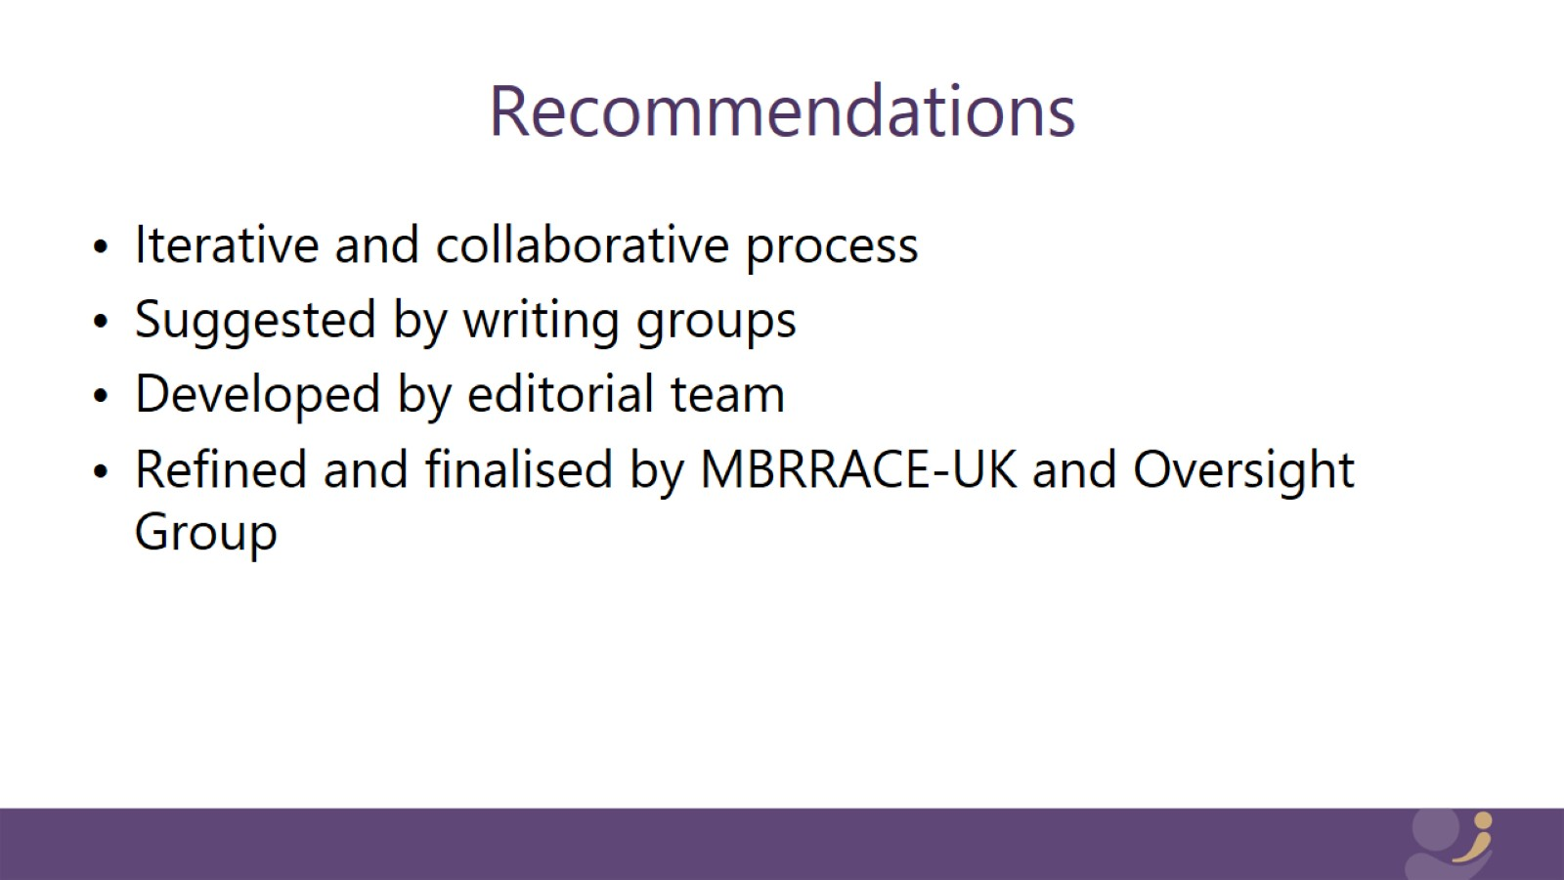
Recommendations

Slide 29


Slide 30
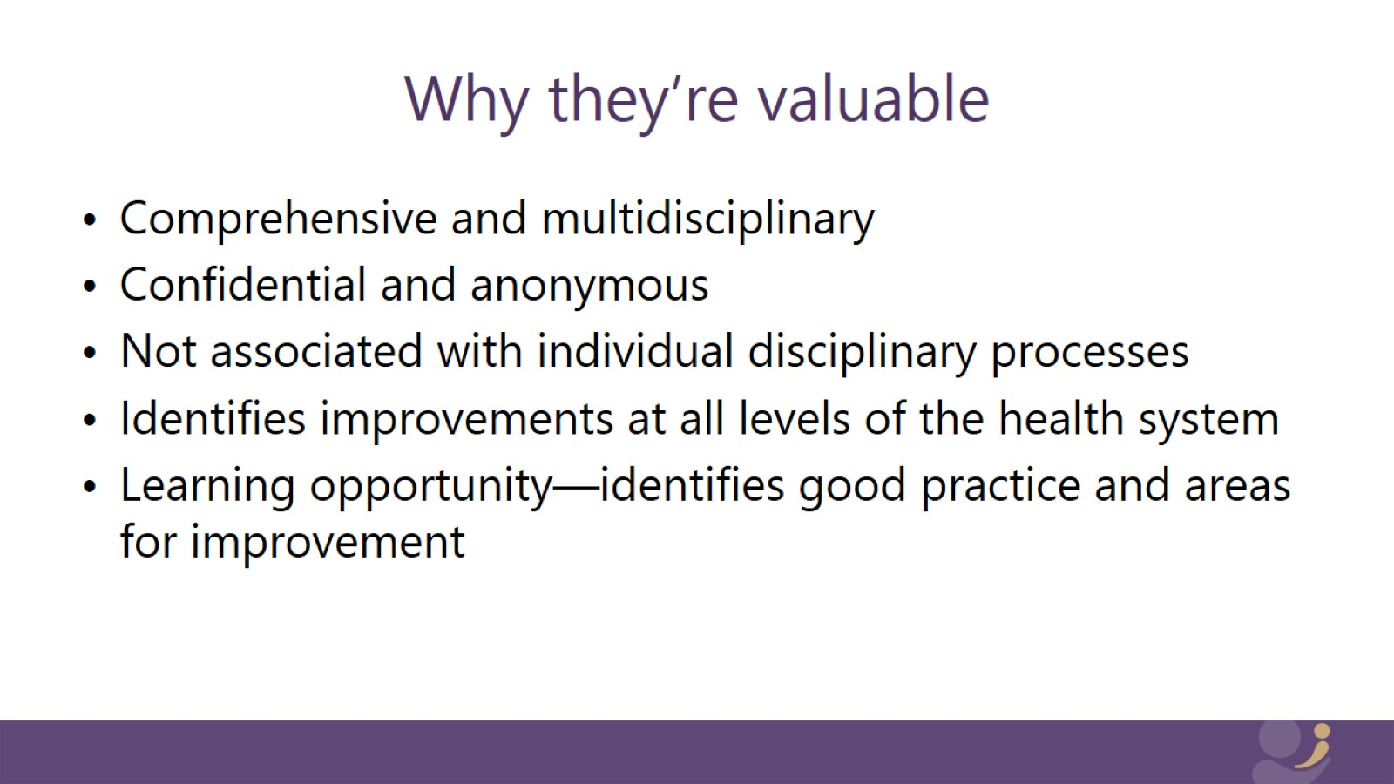
Why they’re valuable

Slide 31
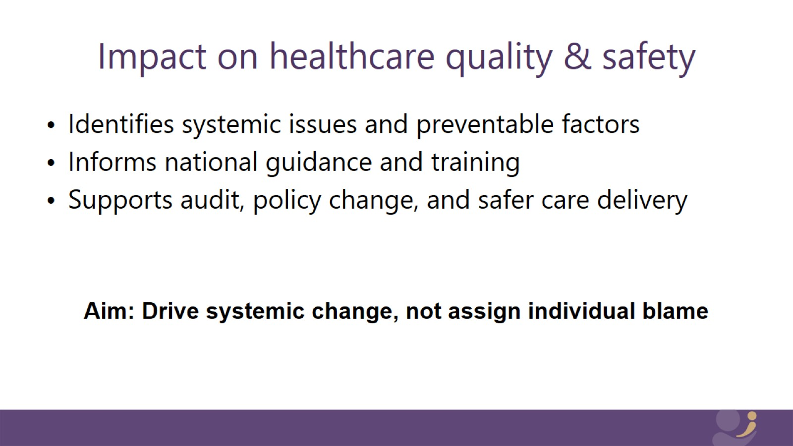
Impact on healthcare quality & safety

Slide 32
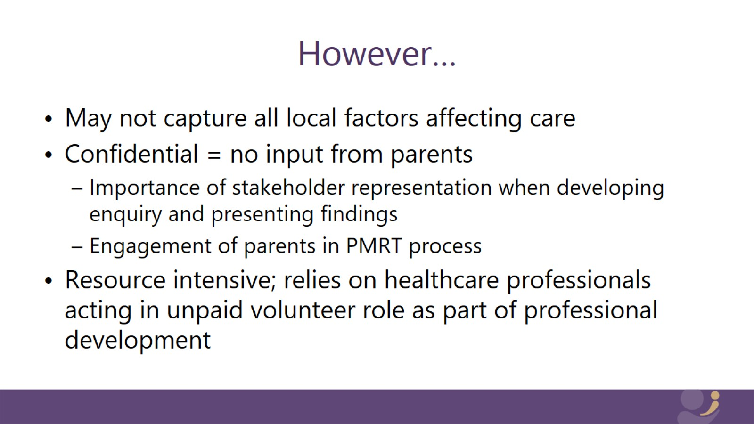
However…

Slide 33


Slide 34
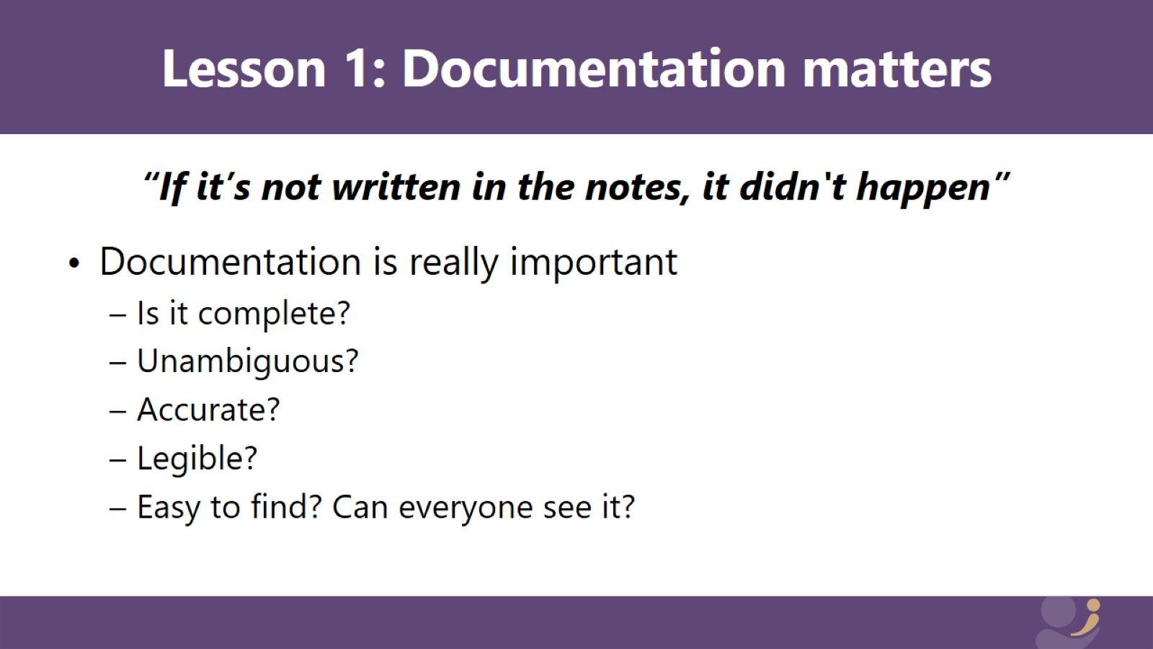
Lesson 1: Documentation matters

Slide 35
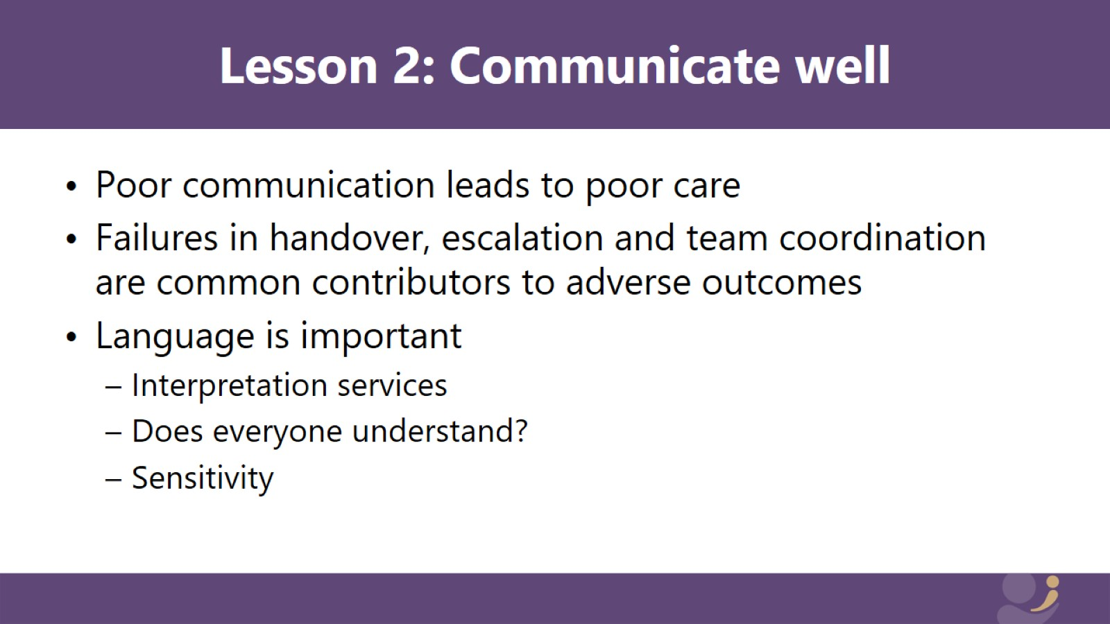
Lesson 2: Communicate well

Slide 36
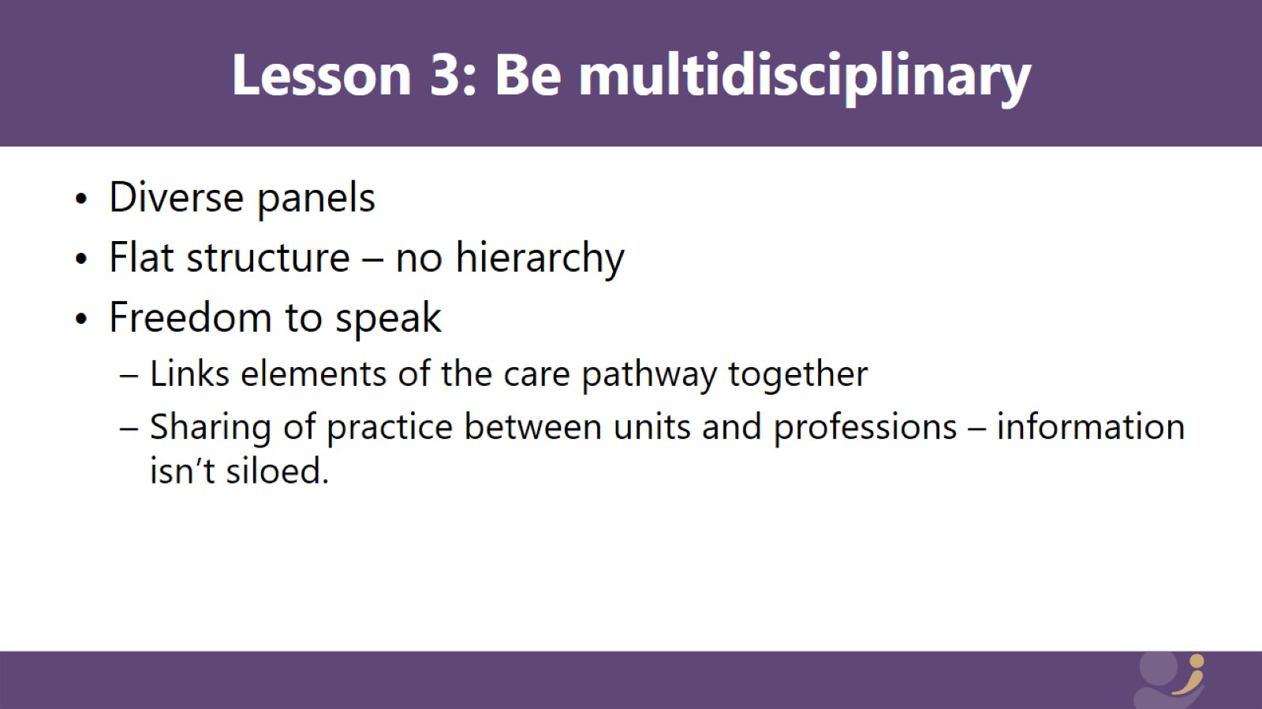
Lesson 3: Be multidisciplinary

Slide 37
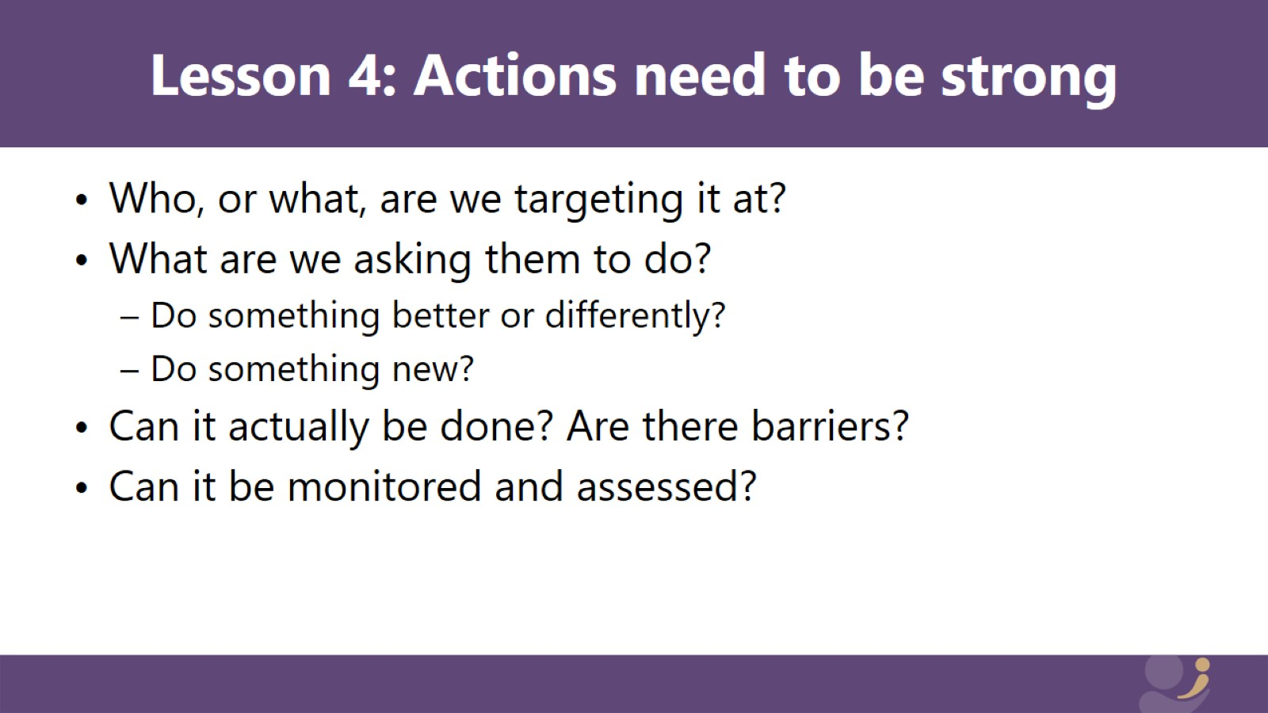
Writing recommendations

Slide 38
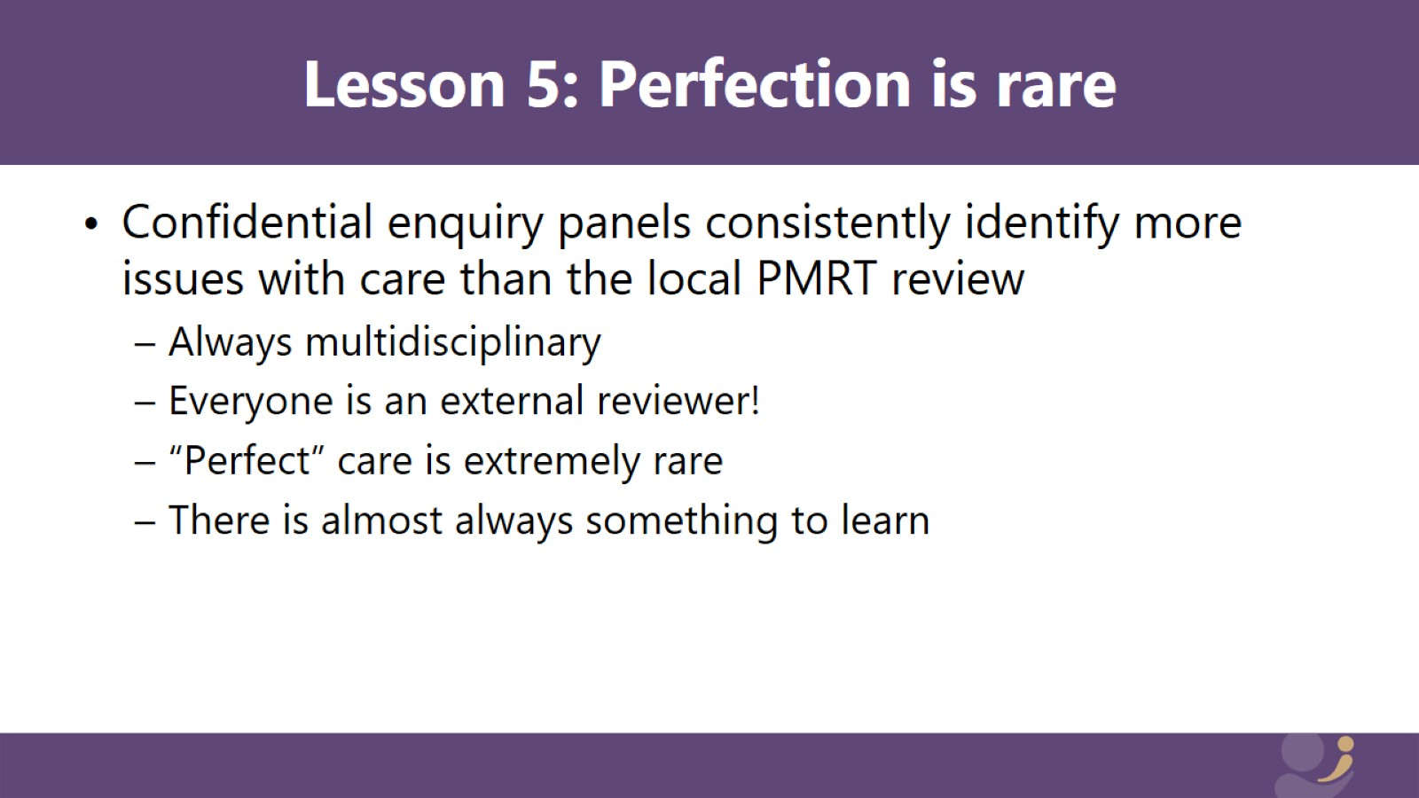

Slide 39


Slide 40
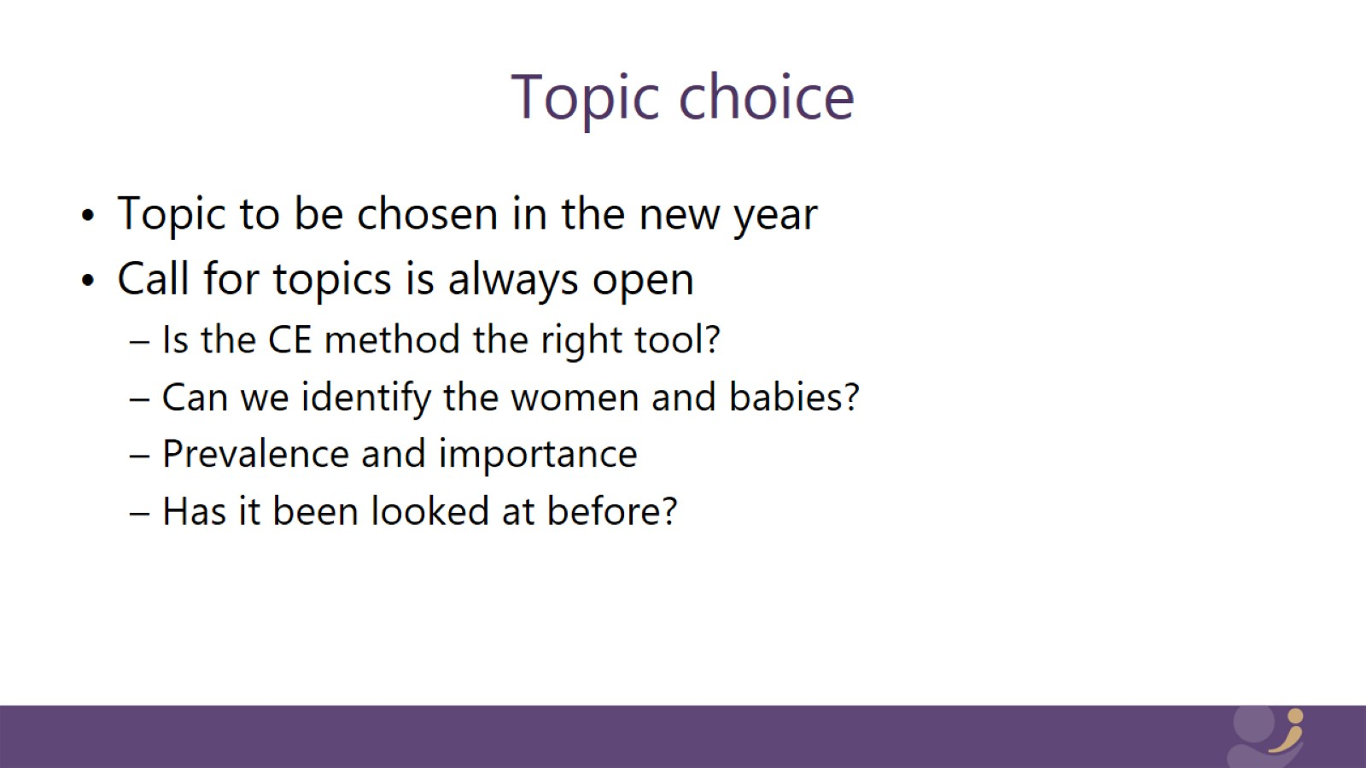
Topic choice

Slide 41
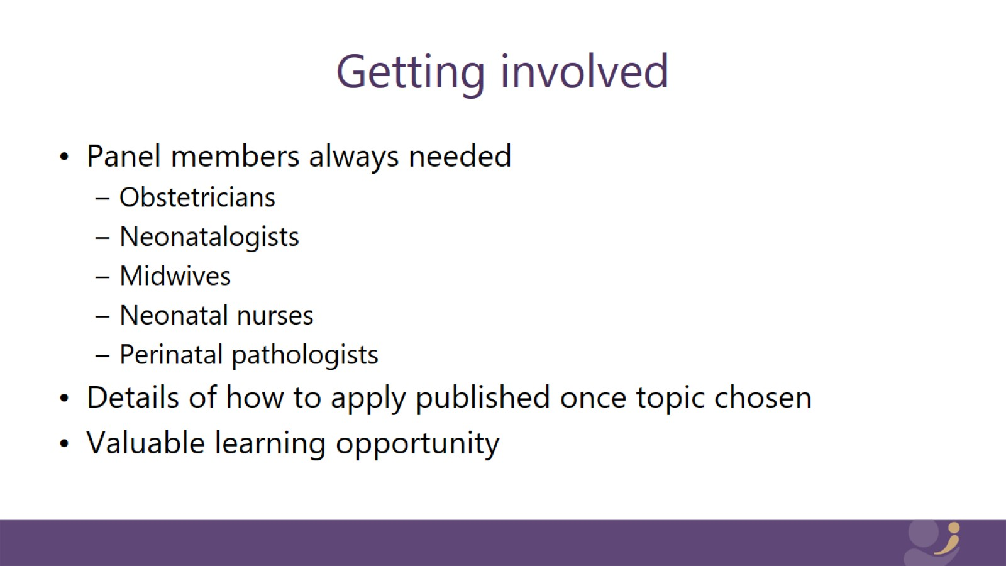
Getting involved

Slide 42

Thank you

